Slide 1


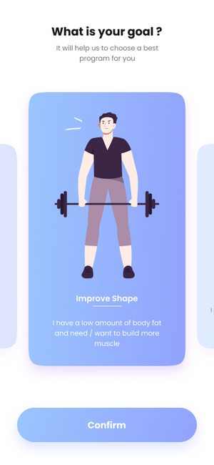
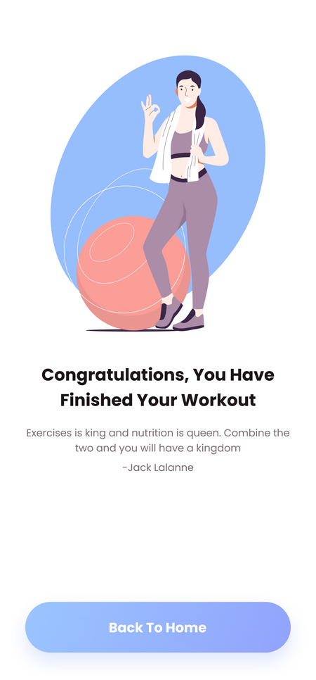
Home
Service
About Us
Contact
FitnestX
Mobile
App

Slide 2
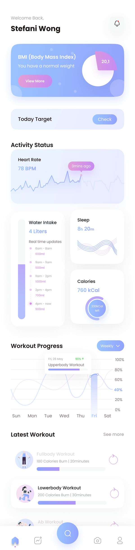
Home
Service
About Us
Contact
Welcome To Our Application
FitnestX is your comprehensive fitness companion, designed to help you stay healthy and achieve your personal fitness goals. Whether you're just starting out or are an experienced fitness enthusiast, FitLife offers all the tools you need in one convenient platform. Simplify your fitness journey by accessing workout plans, tracking your progress, and receiving personalized insights.
Our app allows you to follow custom workout routines, track your daily and long-term activity, and monitor your fitness metrics, like heart rate and calories burned, all in real time. FitLife empowers you to stay motivated, challenge yourself, and get the most out of every workout, all while keeping you informed about your health and fitness progress

Slide 3
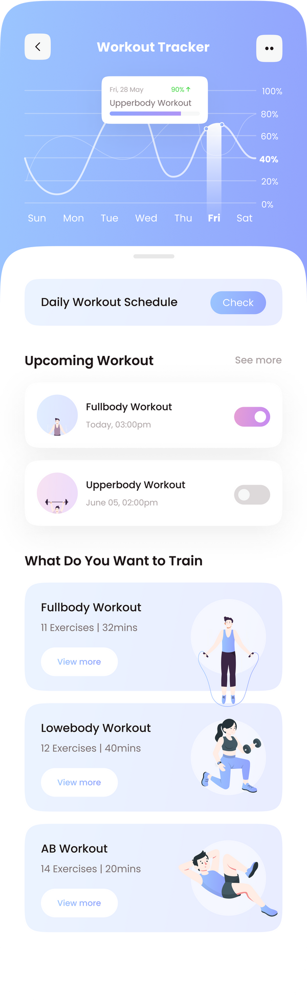
Home
Service
About Us
Contact
Application Advantages
Personalized Workouts
FitLife offers tailored workout plans based on your fitness level and goals, whether you're focusing on weight loss, muscle gain, or overall health improvement.
Variety of Workouts
Explore a wide range of exercises from cardio to strength training. FitLife ensures that you have access to diverse workouts that suit your preferences and fitness goals, helping you avoid boredom and stay motivated.
01
04
Real-Time Progress Tracking
Monitor your workouts and health metrics in real time, including heart rate, calories burned, and duration, helping you stay on track and make informed decisions about your fitness routine.
Motivation and Goal Setting
Set personalized fitness goals and receive reminders and motivational prompts to stay consistent. Whether it's daily step goals or long-term milestones, FitLife helps keep you accountable.
02
05
Comprehensive Fitness Insights
Receive detailed reports and analysis of your fitness progress. The app provides insights on trends over time, helping you identify areas of improvement and keep pushing towards your goals.
User-Friendly Interface
FitLife features an intuitive, easy-to-navigate interface, making it simple for anyone to manage workouts, track progress, and stay engaged in their fitness routine without any hassle.
06
03

Slide 4
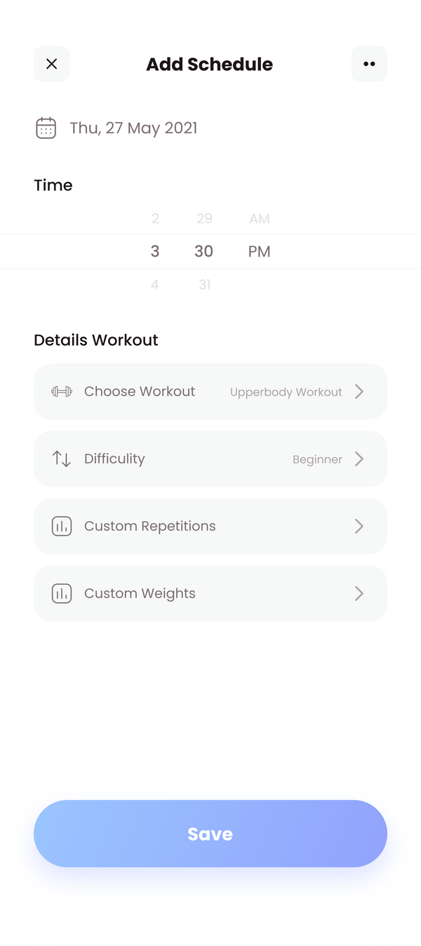
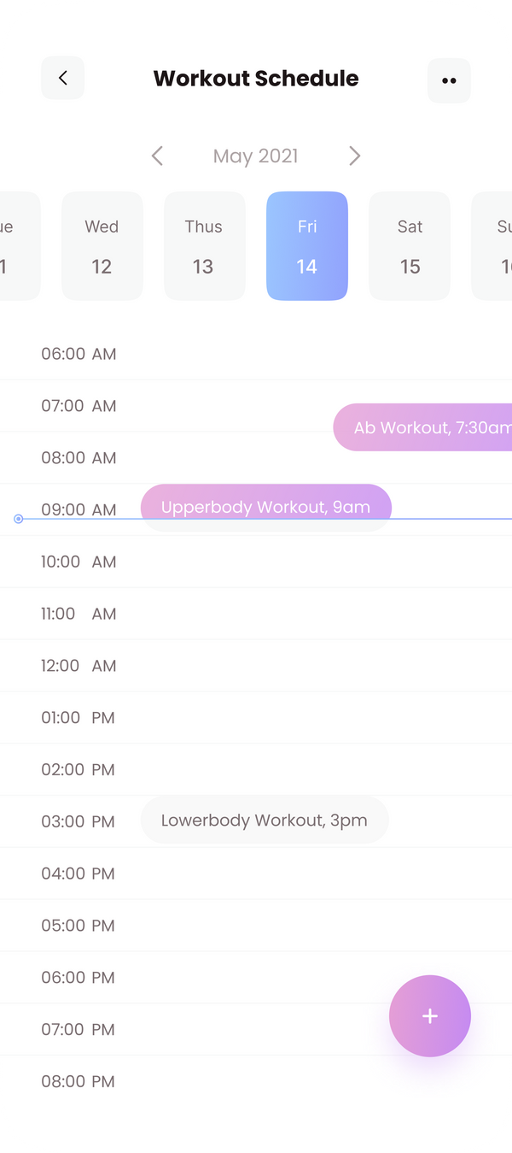
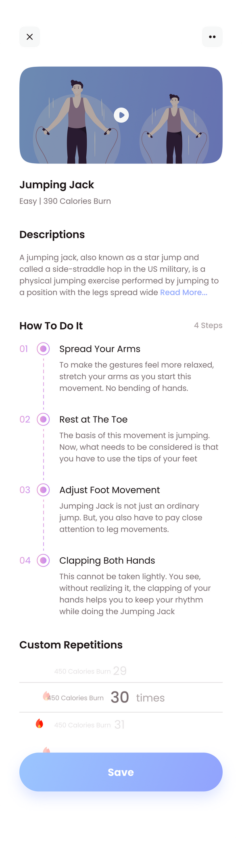
Home
Service
About Us
Contact
Menu Display
01
Add Schedule
Easily plan your workouts by adding them to your personalized schedule.Select from different workout types and choose the best time for each session to stay organized and on track.
02
Workout Schedule
View your scheduled workouts in a clear calendar format. Stay on top of your routine by seeing which workouts are planned for the day, week, or month.
03
Exercise Instructions
Access detailed workout instructions, including video demonstrations. Follow easy step-by-step guides to ensure proper form and maximize the effectiveness of each exercise.

Slide 5
Home
Service
About Us
Contact
Application Features
01
Daily workout schedule: This feature allows users to see a schedule of their daily workouts.
02
What do you want to train? This feature allows users to choose which body parts they want to train.
03
How to do it: This feature provides instructions on how to do each workout.
04
Custom repetitions: This feature allows users to customize the number of repetitions they do for each workout.

Slide 6
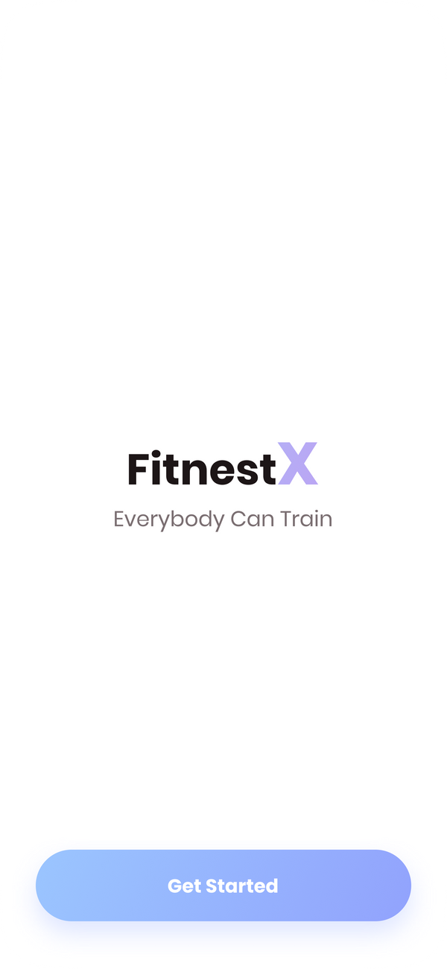



Home
Service
About Us
Contact
Your Progress
Strength Gains
Endurance
Weight Loss

Slide 7
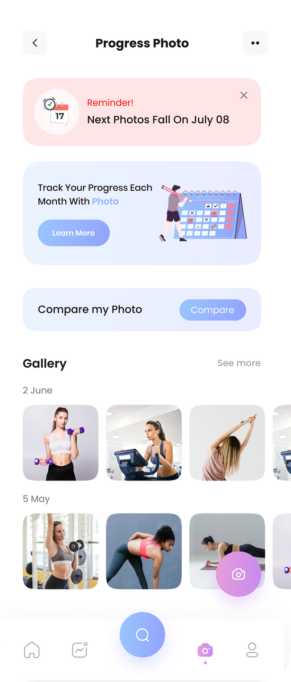
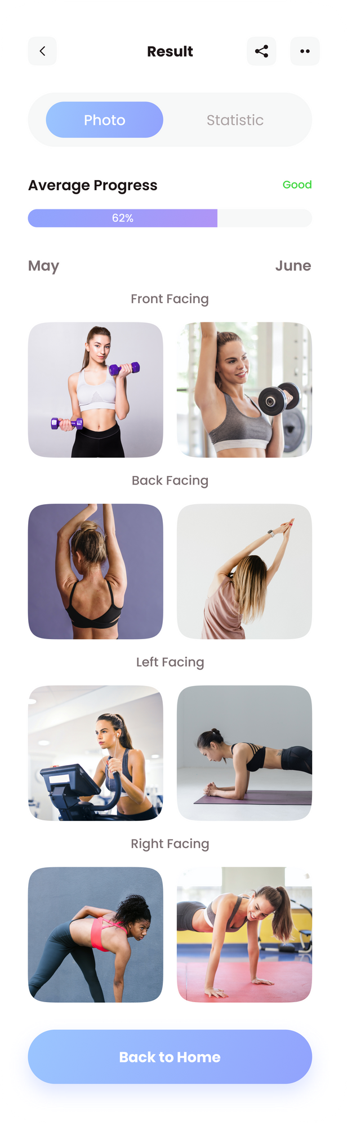
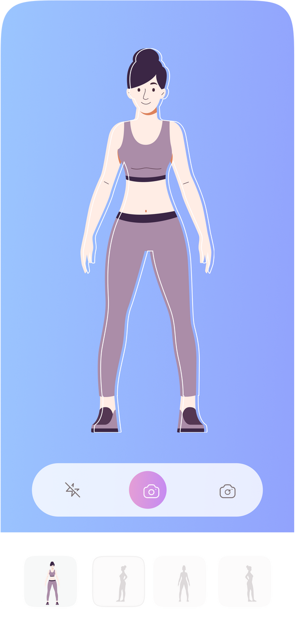
Track Your Fitness Journey
Home
Service
About Us
Contact
Easily track your fitness progress over time. View photos, set goals, and compare your progress as you reach new milestones. Stay motivated and watch your transformation happen
01
Progress Tracking
Monitor your overall fitness with detailed progress tracking. Compare your strength, cardio, and flexibility improvement across different periods
02
Gallery and Milestones
Capture your fitness journey with progress photos. View a side-by-side comparison of your past and current states, keeping your motivation high.

Slide 8
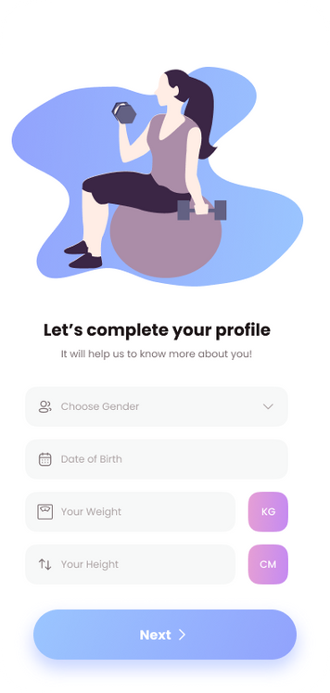

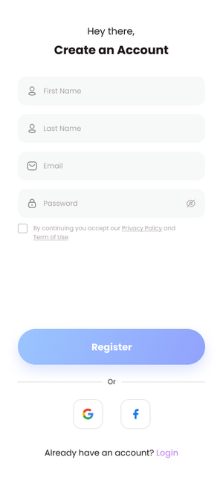
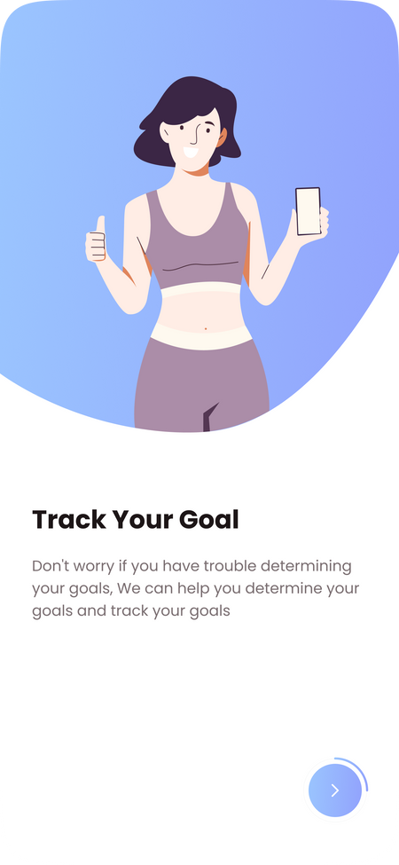
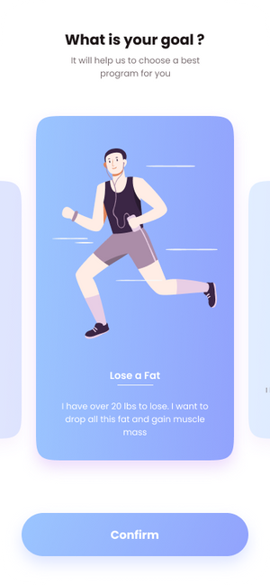
Home
Service
About Us
Contact

Slide 9
Home
Service
About Us
Contact
Our Team
Menna Tarek
Sara Elsayed
Mina Ayman
Youssef Hesham
Tasneem Mohammed

Slide 10

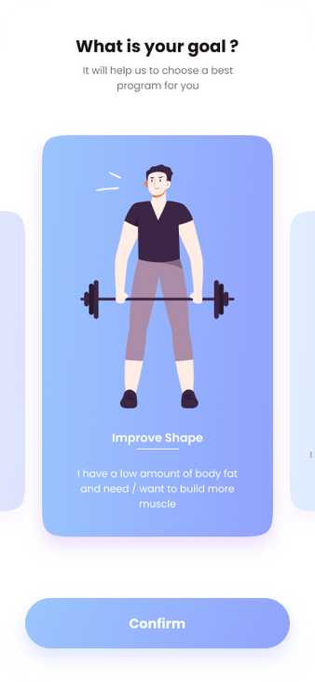
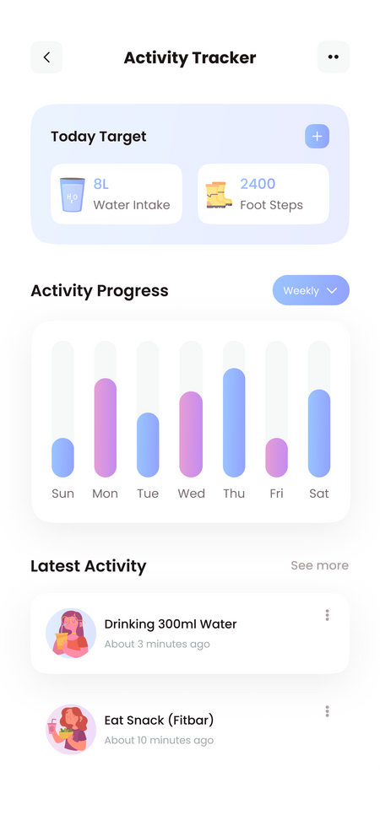
Home
Service
About Us
Contact
Thank You

